Slide 1




Course : Machine Learning
Lecture On: Logistic Regression
Instructor: Manish Kumar
EdEditit MaMastesterr tetexxtt stystyleless
2

Slide 2
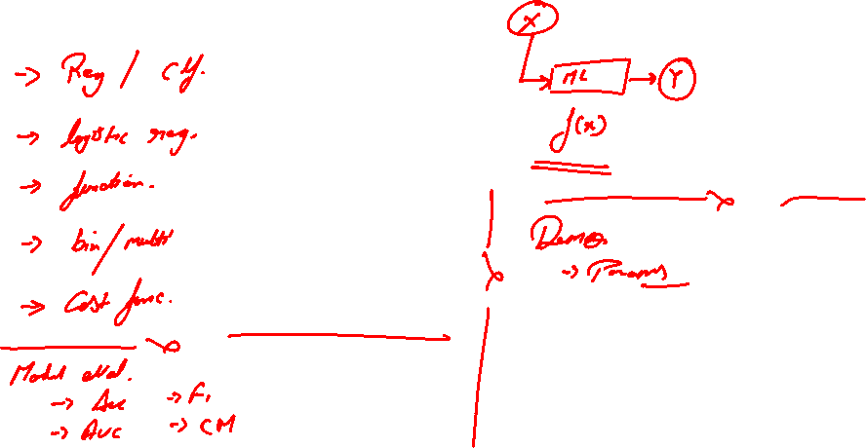

Slide 3
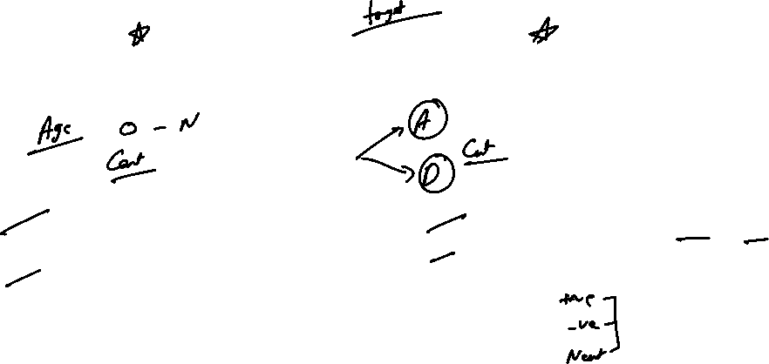
Regression v/s Classification
Regression
Used when output is a Continuous Variable
Want to predict the actual value of something
Classification
Used when output is a Discrete Variable
Want to predict different classes
Examples of Regression problems
Given an image, predict the number of “likes” that the image will get on Facebook
Given a product on Amazon, how many units will it sell next month?
Examples of Classification problems
Given an image, does it contain a “cat” or a “dog”?
Given a review on Amazon, is the sentiment of the review “positive” or “negative”?

Slide 4
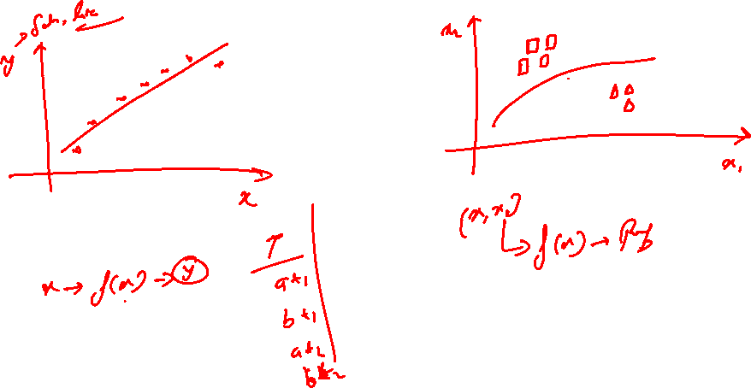

Slide 5
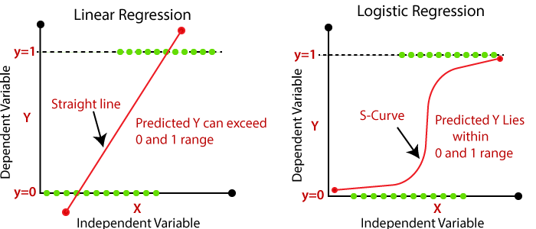
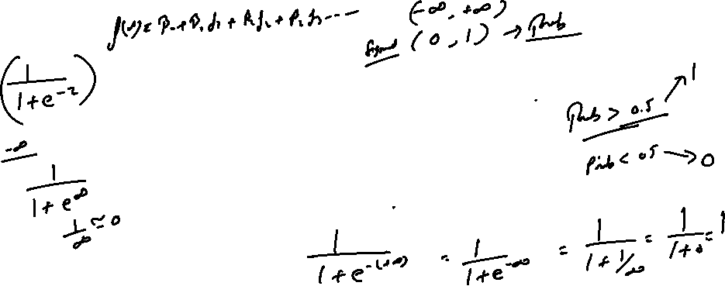
What is logistic regression?
Logistic regression is a classification algorithm used to assign observations to a discrete set of classes. Unlike linear regression which outputs continuous number values, logistic regression transforms its output using the logistic sigmoid function to return a probability value which can then be mapped to two or more discrete classes.

Slide 6
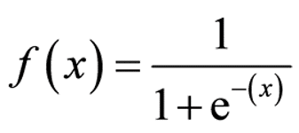
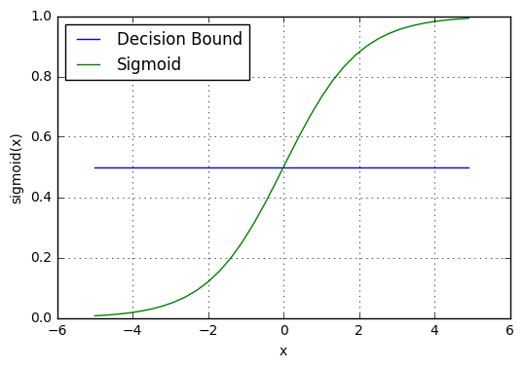
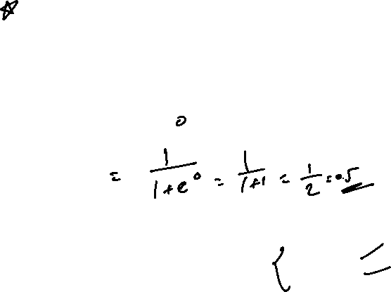
Logistic regression
Sigmoid activation
In order to map predicted values to probabilities, we use the sigmoid function. The function maps any real value into another value between 0 and 1. In machine learning, we use sigmoid to map predictions to probabilities.
Decision boundary
Our current prediction function returns a probability score between 0 and 1. In order to map this to a discrete class (true/false, cat/dog), we select a threshold value or tipping point above which we will classify values into class 1 and below which we classify values into class 2.
p≥0.5,class=1
p<0.5,class=0
def sigmoid(z): return 1.0 / (1 + np.exp(-z))

Slide 7
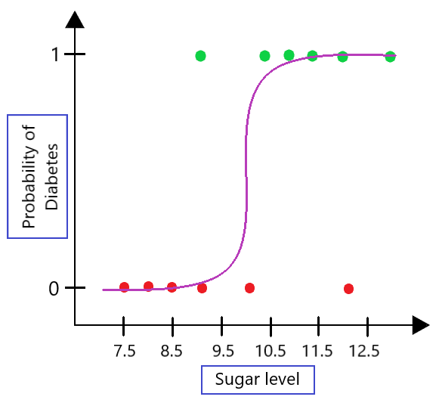


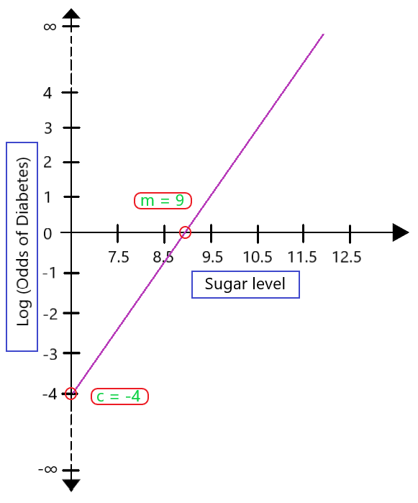


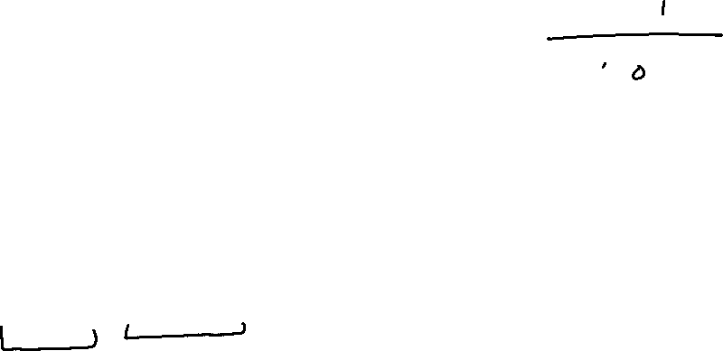
Concept of Log Odds
Odds: Odds are the chances of success divided by the chances of failure. It is represented in the form of a ratio.
Log Odds in Logistic Regression (Logit Functions)

Slide 8
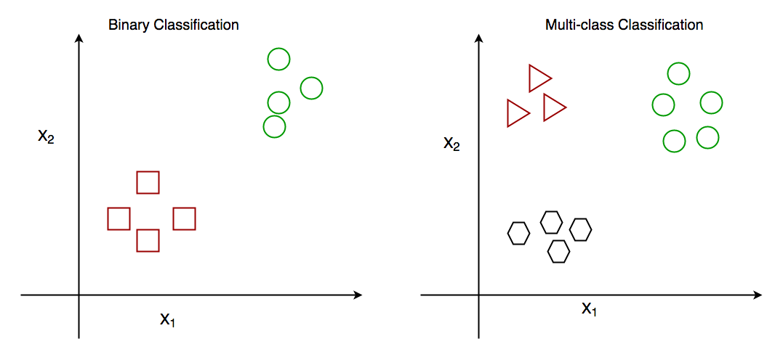
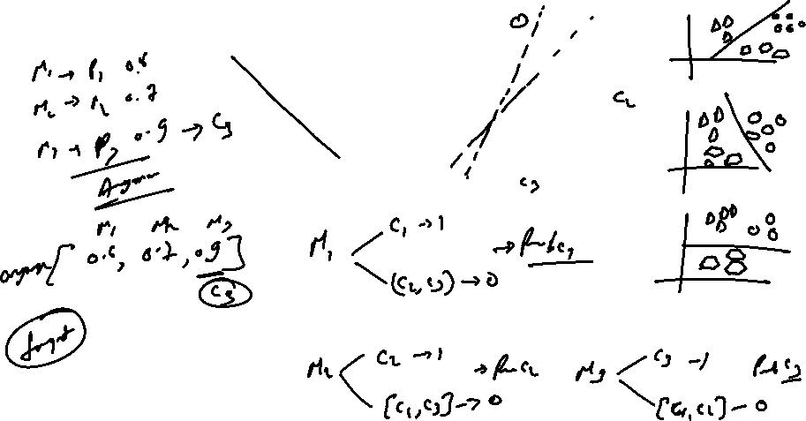
Types of Logistic Regression
Binary Classification : Target variable can take only two categorical values
Multiclass Classification: target variable can take multiple categorical values

Slide 9
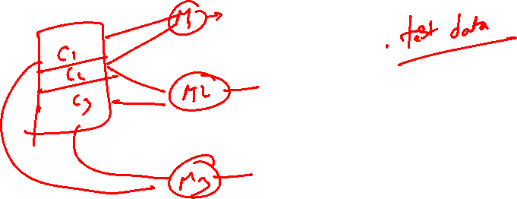

Slide 10
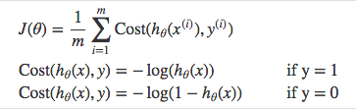
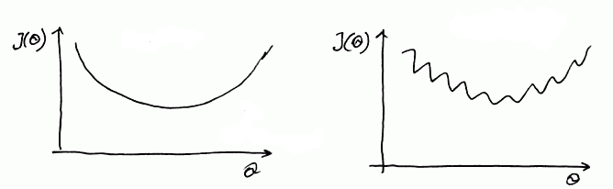
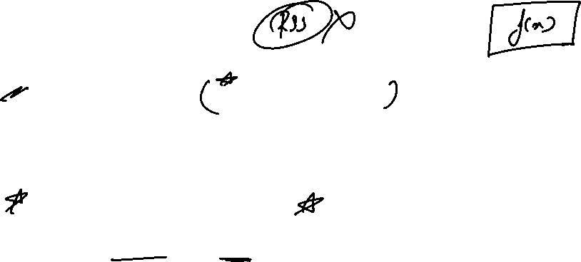
Logistic regression
Cost function
But we shouldn’t use the same cost function MSE as we did for linear regression.
Why? You can refer to chapter 3 of Michael Neilson’s deep learning book for the complete explanation.
For now
it’s because our prediction function is non-linear Squaring this prediction as we do in MSE results in a non-convex function with many local minimums.
If our cost function has many local minimums, gradient descent may not find the optimal global minimum.
Convex
Non - Convex

Slide 11
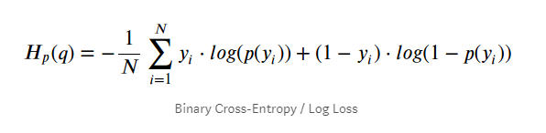
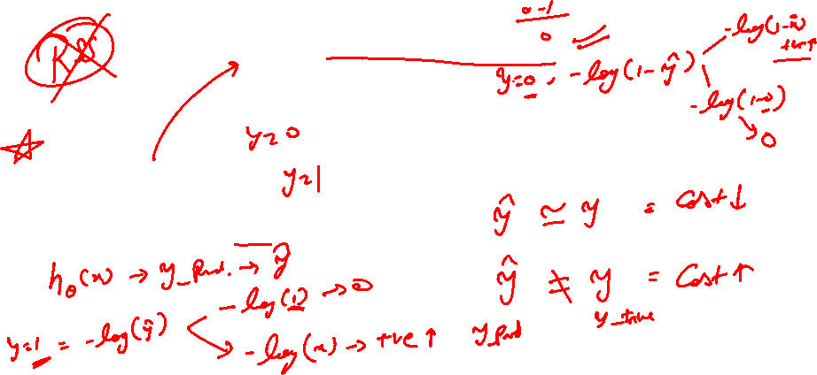

Slide 12
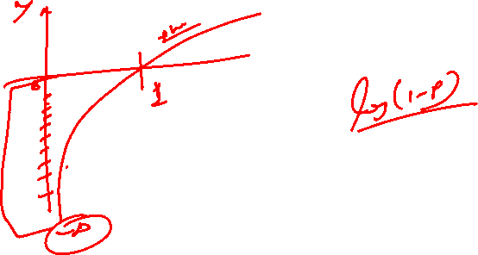

Slide 13
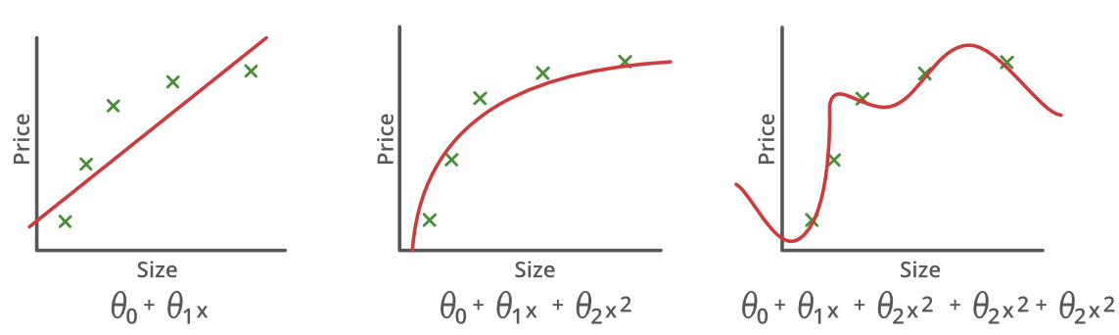
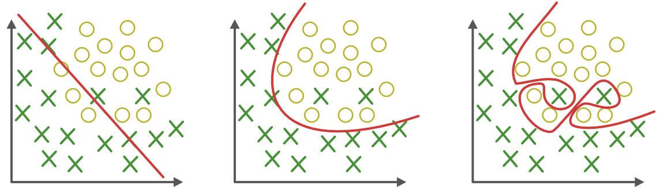
What & Why of Overfitting and Underfitting
Underfitting
Good-Fit
Overfitting

Slide 14
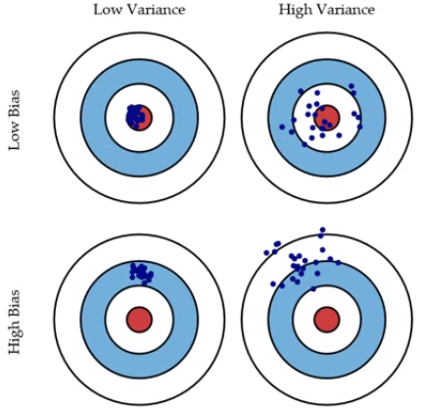
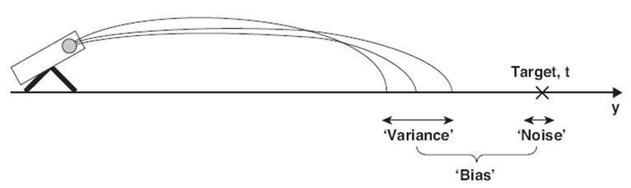
How to tune a model
The prediction error for any machine learning algorithm can be broken down into three parts:
Bias Error
Variance Error
Irreducible Error
The irreducible error cannot be reduced regardless of what algorithm is used. It is the error introduced from the chosen framing of the problem and may be caused by factors like unknown variables that influence the mapping of the input variables to the output variable.

Slide 15
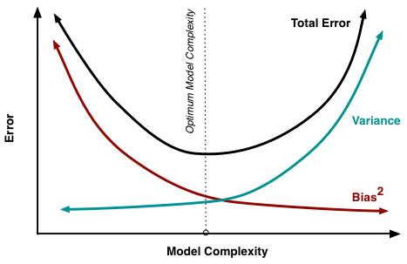
Bias-Variance Trade-Off
The goal of any supervised machine learning algorithm is to achieve low bias and low variance. In turn the algorithm should achieve good prediction performance.
Parametric or linear machine learning algorithms often have a high bias but a low variance.
Non-parametric or non-linear machine learning algorithms often have a low bias but a high variance.
The parameterization of machine learning algorithms is often a battle to balance out bias and variance.

Slide 16
Model Evaluation
Confusion Matrix | Target
 | Positive | Negative
Positive | a | b | Positive Predictive Value | a/(a+b)
Negative | c | d | Negative Predictive Value | d/(c+d)
 | Sensitivity | Specificity | Accuracy = (a+d)/(a+b+c+d)
A confusion matrix shows the number of correct and incorrect predictions made by the classification model compared to the actual outcomes (target value) in the data. The matrix is NxN, where N is the number of target values (classes). Performance of such models is commonly evaluated using the data in the matrix. The following table displays a 2x2 confusion matrix for two classes (Positive and Negative).
Accuracy : the proportion of the total number of predictions that were correct.
Positive Predictive Value or Precision : the proportion of positive cases that were correctly identified.
Negative Predictive Value : the proportion of negative cases that were correctly identified.
Sensitivity or Recall : the proportion of actual positive cases which are correctly identified.
Specificity : the proportion of actual negative cases which are correctly identified.

Slide 17
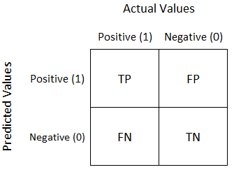
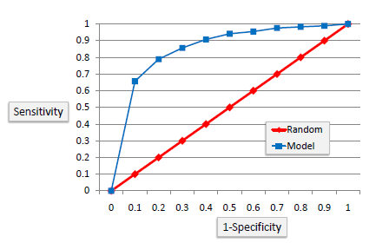
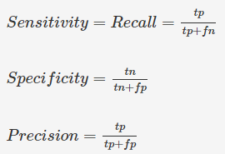

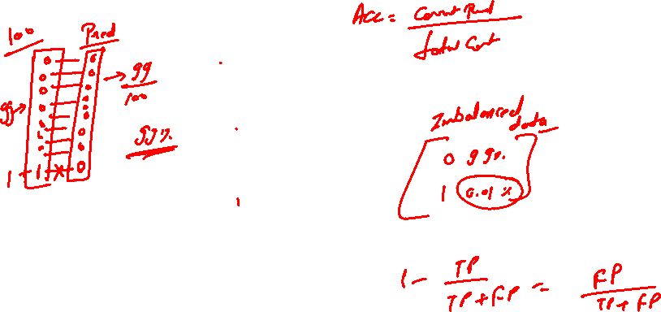
LOGISTIC REGRESSION
A confusion matrix shows the number of correct and incorrect predictions made by the classification model compared to the actual outcomes (target value) in the data.
ROC Curves summarize the trade-off between the true positive rate and false positive rate for a predictive model using different probability thresholds
It’s often used as a proxy for the trade-off between the sensitivity of the model (true positives) vs the fall-out or the probability it will trigger a false alarm (false positives).

Slide 18
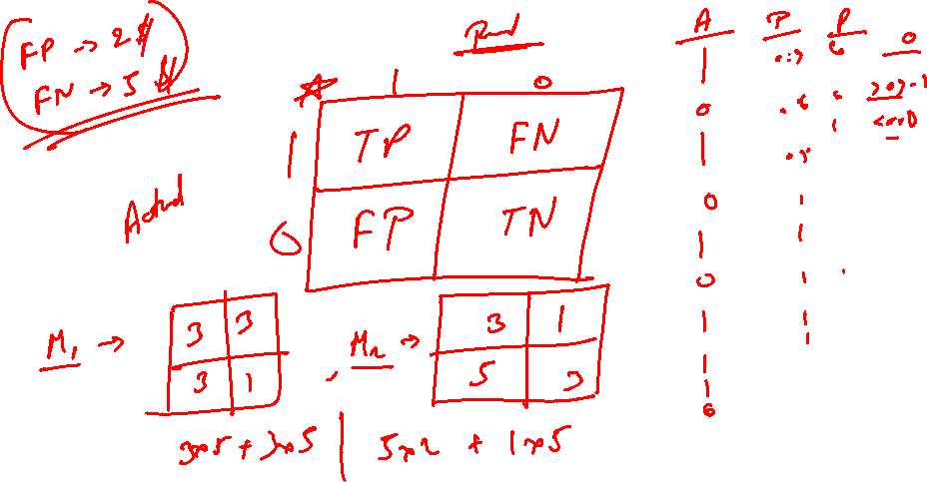

Slide 19
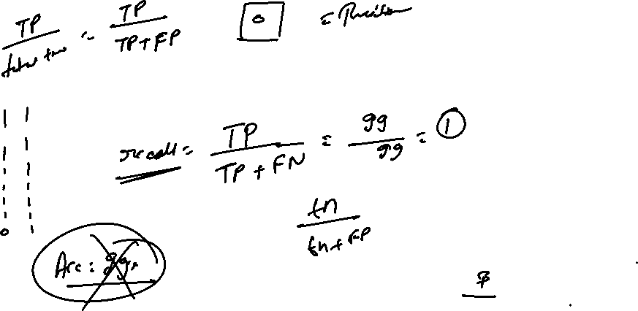

Slide 20
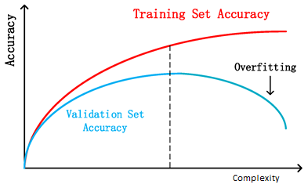
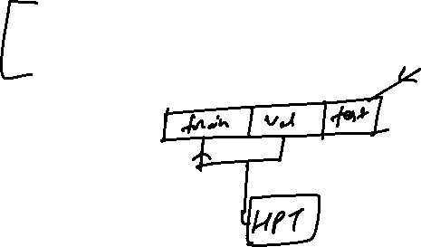
How to Detect Overfitting?
Detecting overfitting is almost impossible before you test the data. It can help address the inherent characteristic of overfitting, which is the inability to generalize data sets. The data can, therefore, be separated into different subsets to make it easy for training and testing. The data is split into three main parts, i.e., a train set ,a test set & a validate set
– Training set: A set of examples used for learning, that is to fit the parameters of the classifier.
– Validation set: A set of examples used to tune the parameters of a classifier, for example to choose the number of hidden units in a neural network.
– Test set: A set of examples used only to assess the performance of a fully-specified classifier.
By segmenting the dataset, we can examine the performance of the model on each set of data to spot overfitting when it occurs. The performance can be measured using the percentage of accuracy observed in train & validate data sets to conclude on the presence of overfitting.

Slide 21

Cross Validation
Cross-validation is a resampling technique used to evaluate machine learning models on a limited data set.
The most common use of cross-validation is the k-fold cross-validation method. Our training set is split into K partitions, the model is trained on K-1 partitions and the test error is predicted and computed on the Kth partition. This is repeated for each unique group and the test errors are averaged across.

Slide 22
Let’s see code examples

Slide 23



Thank You!
#LifeKoKaroLift
24
https://www.geeksforgeeks.org/role-of-log-odds-in-logistic-regression/

